Slide 1
GauchoShare Team Final Presentation
Let Resource Sharing around UCSB Community Becomes Much Easier!

Slide 2
Catalogue:
1. Current Solutions & Exigency
2. Product & Team Introduction
3. Detailed Features Presentation & Explanation
4. Challenges & Gains
5. Expectations & Questions

Slide 3
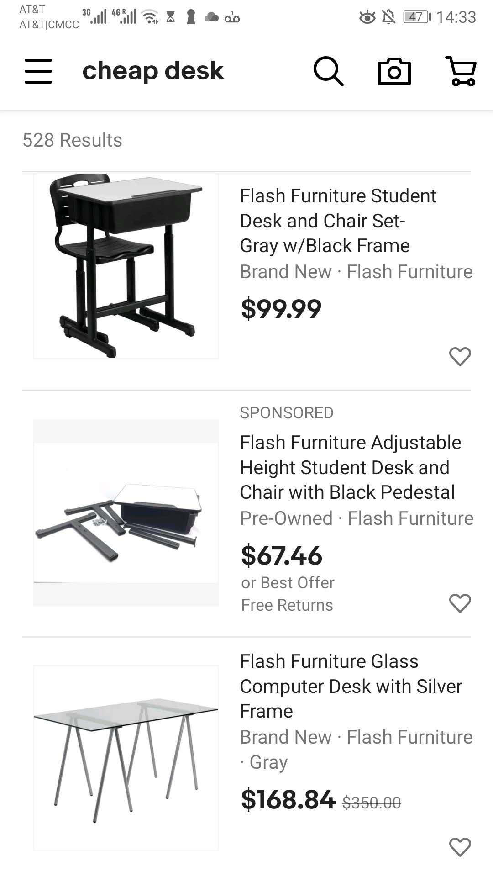
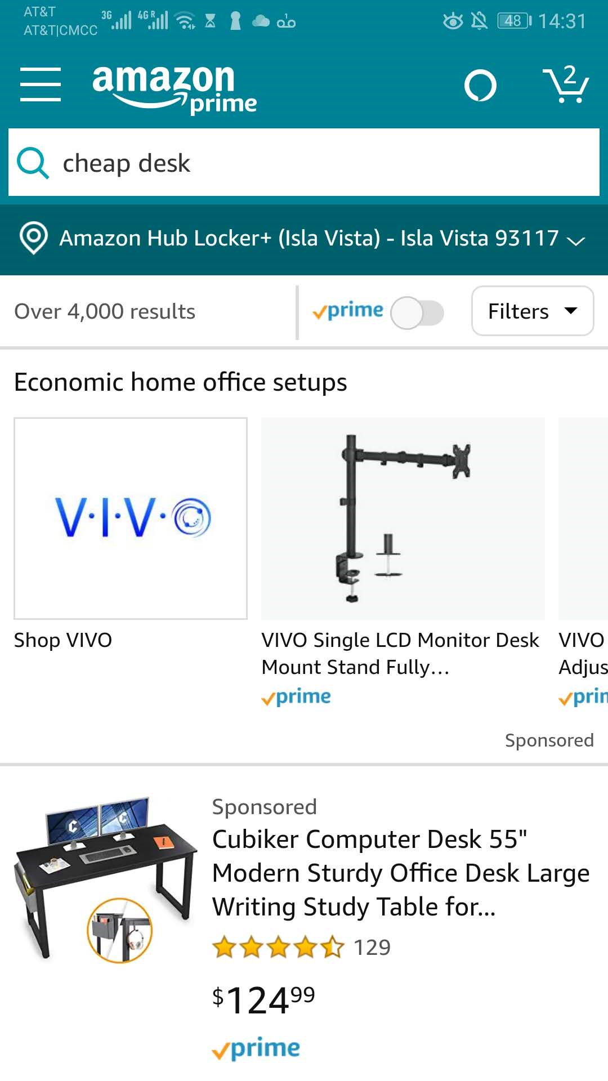
Current Solutions
eBay:
Pros:
1 Both new and used
Cons:
1. Not cheap
2. Credibility on doubt
3. Longer shipping time
Amazon:
Pros:
1. Mostly new items
2. Credible sellers
Cons:
1. Long Shipping time
2. Very expensive

Slide 4
Exigency
It’s very hard for students and other residents living in UCSB community to find items (resources) that satisfy all the following conditions:
Cheap
Credible
Fast pickup/shipping
At the same time, students and residents willing to sell qualified items can’t find buyers.

Slide 5
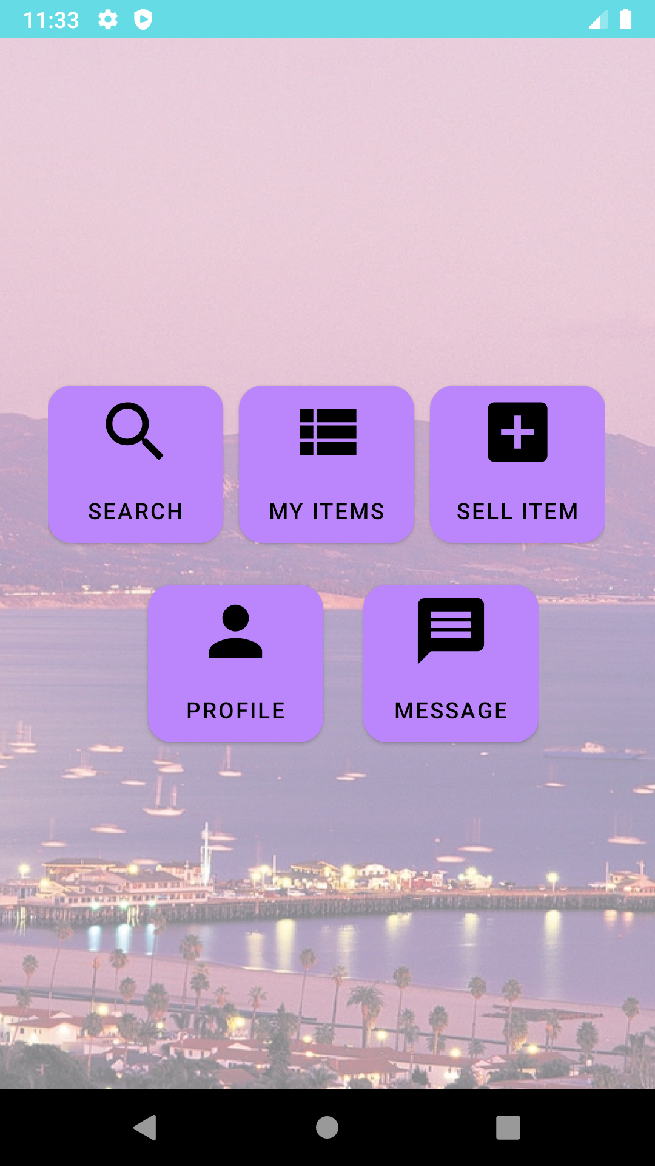
2. The Solution Is: ... Our GauchoShare App!

Slide 6
2. Product Introduction & Competitivity
An Android App that connects buyers and sellers of second-handed goods in UCSB community and fosters transaction.
It only shares information (including user identifications, product attributes, payment methods…), but no actual buying or reselling, which cuts out the middleman revenue and lowers product price (also open for bargaining).
It focuses on UCSB community, which increases credibility and reduces shipping/pickup time, thus making the transaction of second-handed good (usually harder than new one) much easier.

Slide 7
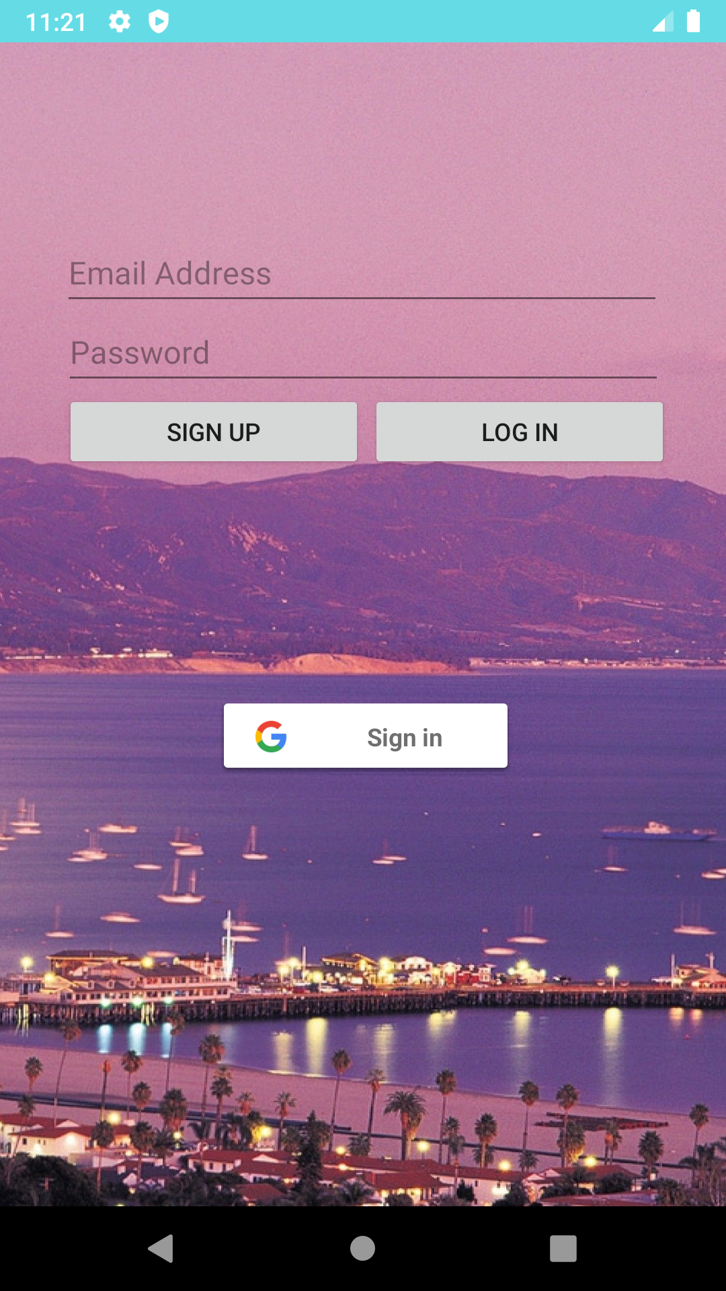
2. Team Introduction
Login/Signup:
Yuehan Li
Main Page/Overall Flow:
Huiyu Zhang
Search: Boru Ai
My Items: Yuehan Li
Sell Item & Profile:
Christopher Yang
Message: Kyle Stubbs

Slide 8
3. Detailed Feature Presentation & Explanation
Go to emulator and enjoy the interactive presentation...

Slide 9
4. Challenges
1. Sooo many states... and ways of redirections (hard for design and planning)
2. Very difficult to be developed iteratively according to the Agile philosophy, since so many features need to work together in the first place.
3. Database schema was changed and improved multiple times, which nullified old data and corresponding tests, and caused multiple related bugs (npe…).
4. UI inconsistency for different features.
5. Multiple unstable APIs from Google (login, picture upload…)

Slide 10
5. Expectation & Questions
P2P model is the future --- no devilous middlemans!
Great Scalability & Maintainability: UCLAShare, UCSDShare, SBCCShare…
Can easily provide more ways of verification/payment/identification…
Questions …?

Slide 11
Thanks!

